Slide 1
DINE & DAZZLE
2012 Heartland Design Awards

Slide 2
Design Statement
A bold, dramatic and dazzling dining room sets the tone for a modern redesign of a single-family home in the suburbs.
This dining room project was for a new client in an upscale neighborhood in Shawnee. The home is 15-20 years old, and the clients had updated most of the public areas on the main floor with a contemporary aesthetic. They were struggling with redecorating the dining room to blend with the rest of the home’s public spaces.
As is typical of homes in the area, the dining room is off the front door and open to the foyer and home office on one side and the living room just beyond the entry. A wide passageway leading to the kitchen borders the room on another side. An interior wall and an exterior wall with large window account for the only walls in the room. Although the layout is typical, the homeowners wanted anything but a typical dining room.
The challenge was to use the dining room to set the tone for the rest of the home’s public area, all of which had already been updated by the client. The homeowners had chosen a neutral palette of black and grey for the home office, living room and kitchen. They wanted to make a bold, dramatic and elegant statement in the dining room while reusing their existing double pedestal dining room table and newly installed chandelier. There was a generous budget for dining chairs, buffet, custom window treatment and accessories.

Slide 3
Design Statement (cont.)
For the dining room, a black and white color palette was chosen for impact and to blend with the rest of the main level. How better to add drama than to paint the two walls black? Boldness would come from the head chairs. Custom window treatments, sculptural wall art and lots of sparkle would add the elegance and dazzle.
After the walls were painted black, a decision was made to paint the existing dining table a shiny black lacquer for a more modern look. A bodacious style was chosen for the host/hostess chairs; the outside backs are upholstered with black and white zebra-printed cowhides and trimmed with silver nail heads. The inside backs and seats are a creamy white fabric treated with fabric protection. Side chairs have curvaceous and classic lines and are upholstered in a creamy white leather with tufted inside backs and also trimmed with silver nail heads.
The ceiling is painted cream with a subtle, champagne metallic faux finish. Ceiling-to-floor, stationary pinch-pleated panels were custom constructed from a black and grey sheer fabric lined in black. To add a bit of sparkle, black and white beaded tassels were handmade and added to each pleat for a highly custom effect.

Slide 4
Design Statement (cont.)
The hunt was on for a buffet, but after much searching we just didn’t find the perfect piece. Could a very traditional Italianate buffet be reconfigured to work? The black granite top got the nod, but the carved pilasters would have to be removed from the two front corners. The piece was painted silver metallic and given a champagne glaze. Custom cut mirror panels were mounted to the corners where the carved pilasters had been, door panels were replaced with custom-sized mirrors, and crystal knobs replaced the original brass pulls. By reworking an existing piece we achieved a glamorous, custom look.
To accent the wall above the buffet a collage of porcelain plates was arranged. These iridescent white, sculptural art pieces are a dramatic contrast to the black walls. Tall and narrow buffet lamps frame the arrangement. Other walls were left unembellished so this focal wall has no competition.
This project is unique in that it incorporates furniture and lines considered traditional in an updated way. The black and white palette plus injections of crystal and mirrored elements seal the deal on the modern design. Reusing and reworking two primary furniture pieces is very today. The homeowners now have a highly customized space to dine and dazzle their friends and family.

Slide 5
Consolidated Design Statement
A bold, dramatic and dazzling dining room sets the tone for a modern redesign of a single-family home in the suburbs.

Slide 6
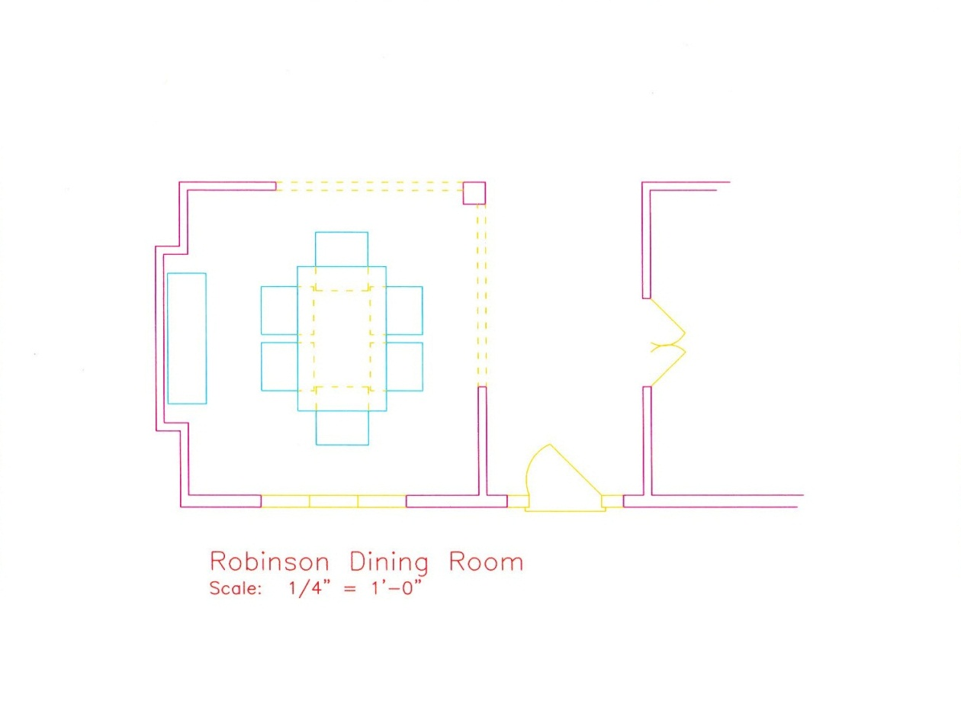
Floor Plan/Space Planning

Slide 7
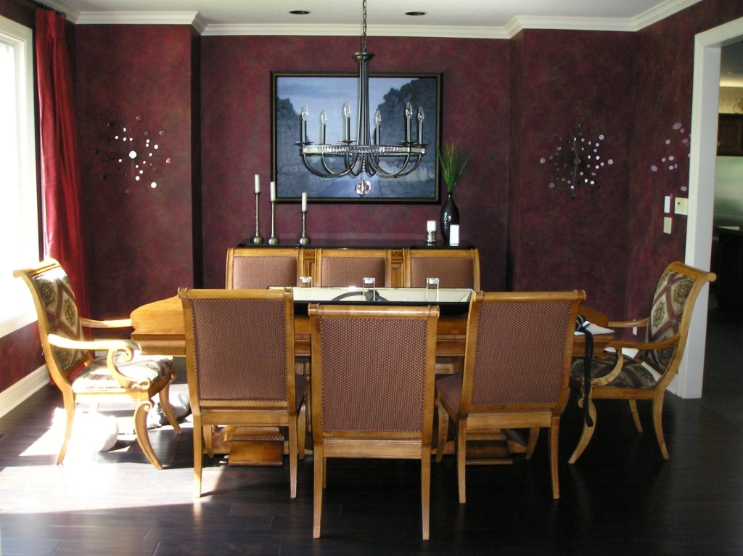
BEFORE

Slide 8
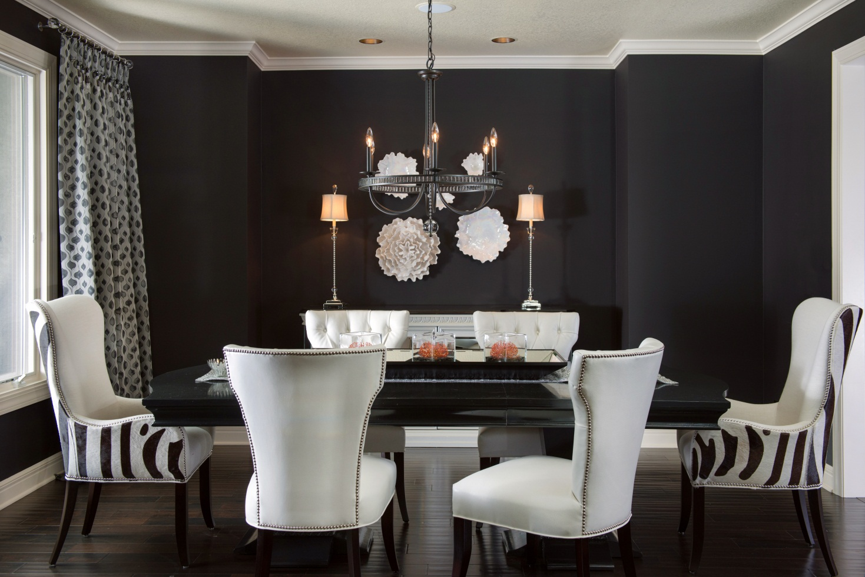
AFTER: Room View

Slide 9
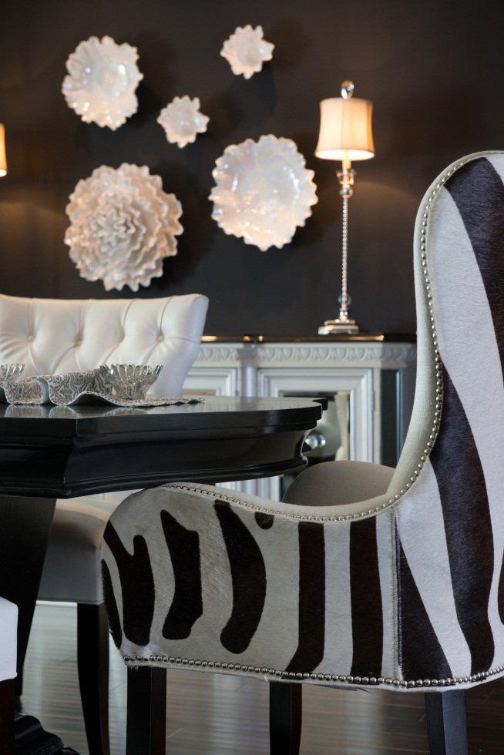
AFTER: Chair Detail

Slide 10
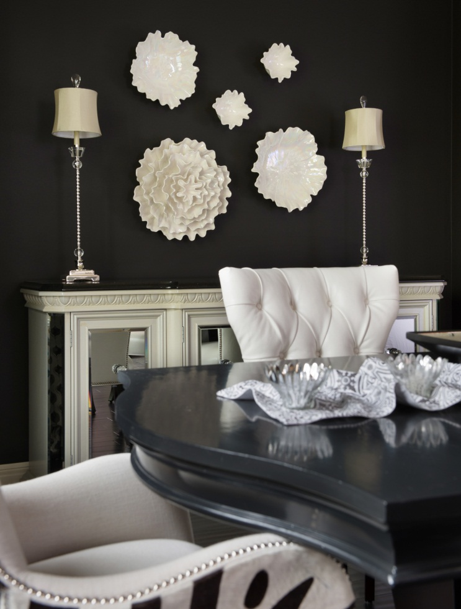
AFTER: Buffet

Slide 11
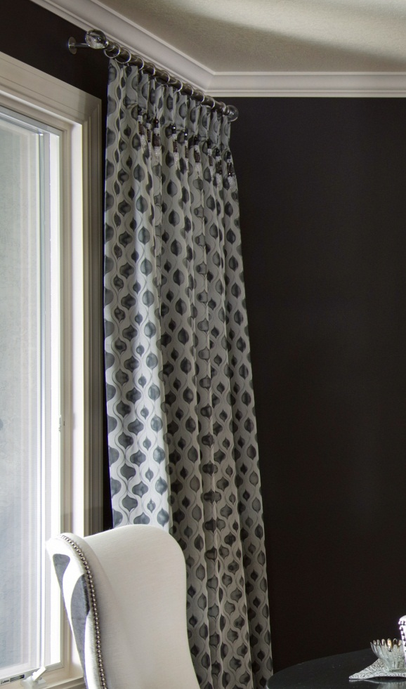
AFTER: Window Treatment

